Slide 1
图像处理的相关方法
离散傅立叶变换
低通滤波器及其应用
高通滤波器及其应用
循环卷积
图像去噪的其他方法

Slide 2
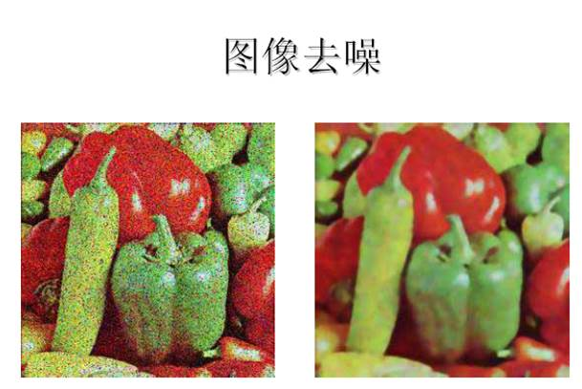

Slide 3
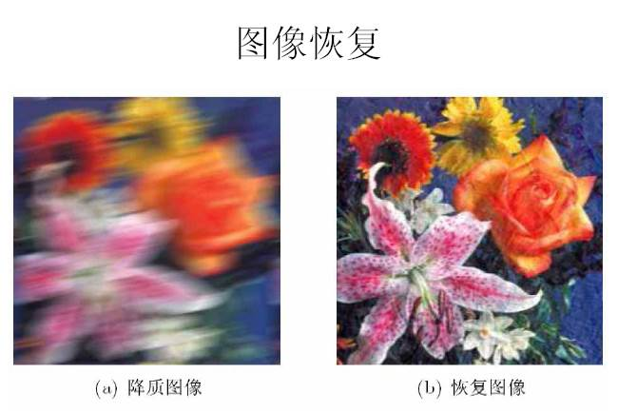

Slide 4
Representing Digital Images
The representation of an M×N numerical array as

Slide 5
Fourier Series

Slide 6

Fourier Series: Example

Slide 7
The Discrete Fourier Transform (DFT) of One Variable and Its Inverse
DFT
IDFT

Slide 8
2-D Discrete Fourier Transform and Its Inverse

Slide 9
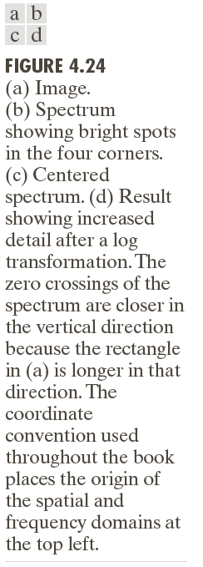

Slide 10
ILPF Filtering Example

Slide 11
Image Smoothing Using Frequency Domain Filters: ILPF

Slide 12
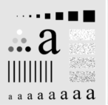
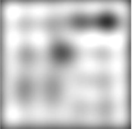
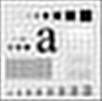
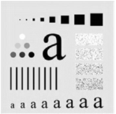
ILPF Filtering Example

Slide 13
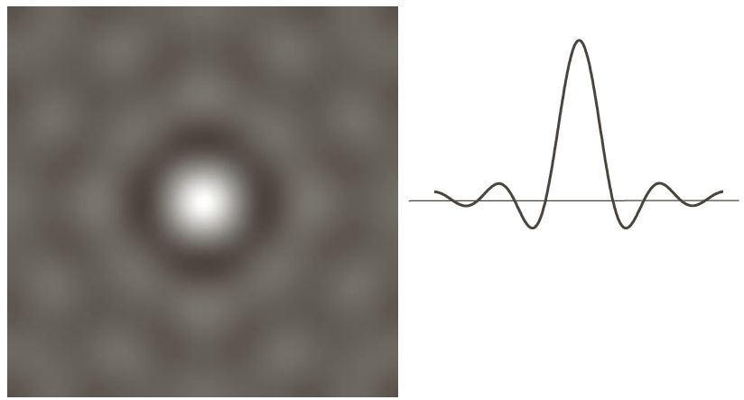
The Spatial Representation of ILPF

Slide 14
Image Smoothing Using Frequency Domain Filters: GLPF

Slide 15
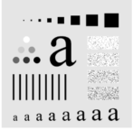
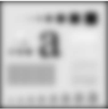
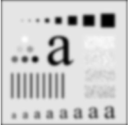
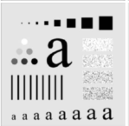
GLPF Filtering Example

Slide 17
Examples of smoothing by GLPF (1)

Slide 18
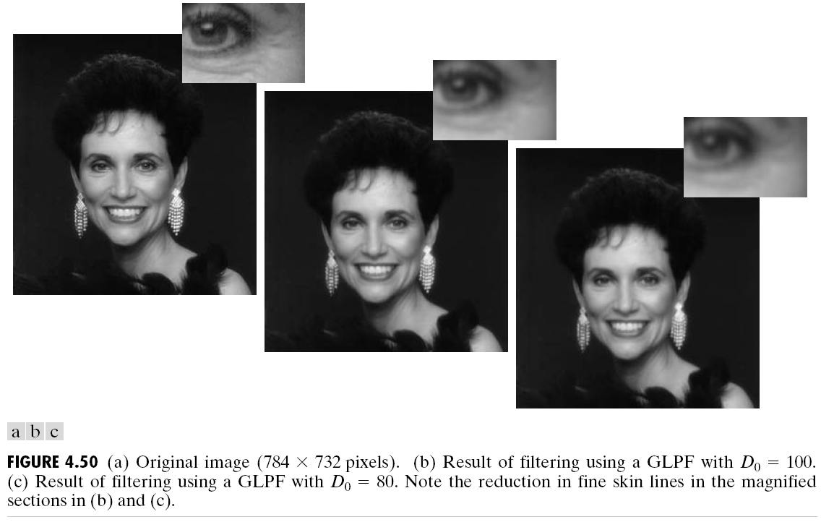
Examples of smoothing by GLPF (2)

Slide 19
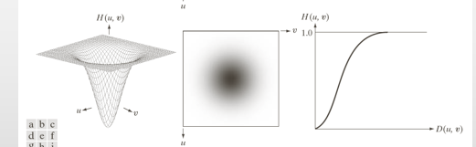
Image Sharpening Using Frequency Domain Filters

Slide 20
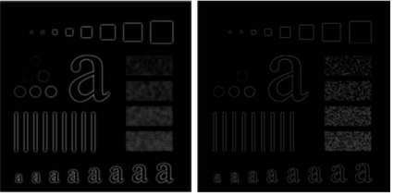
Filtering Results by GHPF

Slide 21
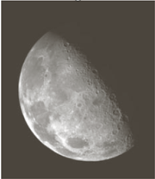
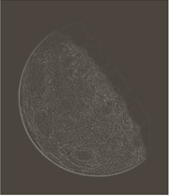
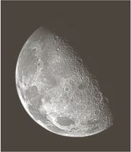
图像
增强

Slide 22
Using Highpass Filtering and Threshold for Image Enhancement

Slide 23
2-D Convolution Theorem

Slide 24
ILPF Filtering Example

Slide 25
The Spatial Representation of ILPF

Slide 26
空域去除高斯噪声的方法
The noise model:
v = u + ,
where u is the original image, v is the noisy one, and is the Gaussian
noise with mean 0 and standard deviation .

Slide 28
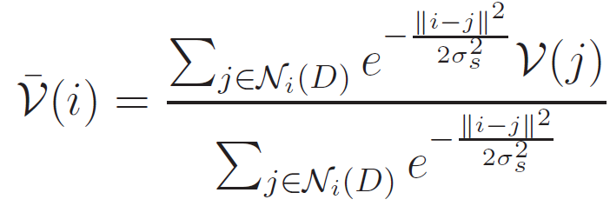
Gaussian filter

Slide 29
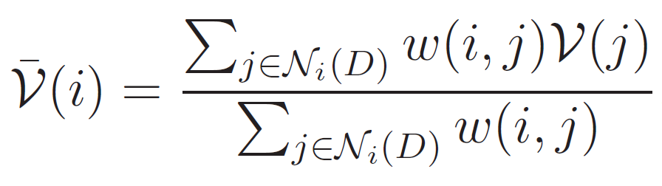
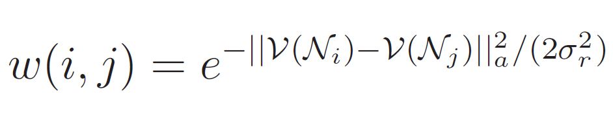
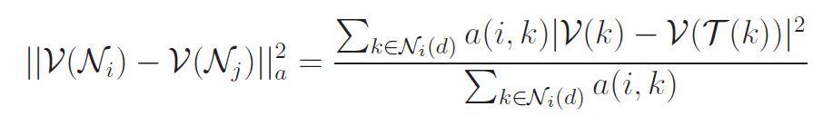
Non-Local means

Slide 31
Gaussian filter
Non-Local means

